Slide 1
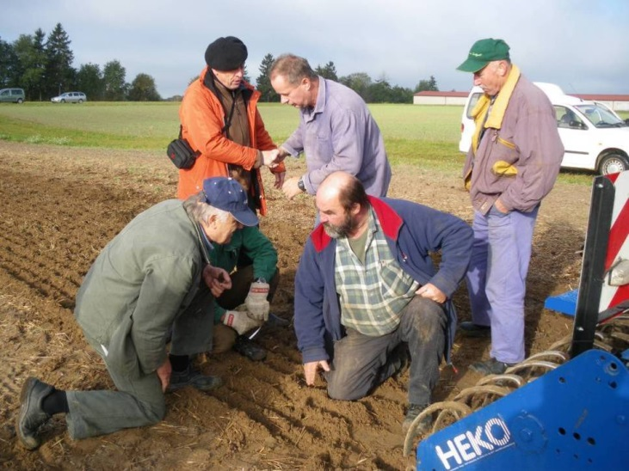
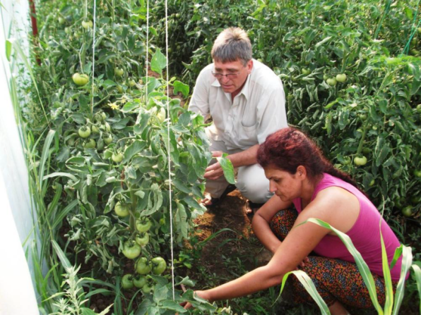

Welcome
to the PRO AKIS
Final conference
University Foundation
Brussels, May 20, 2015

Slide 2
Programme of the day
20th of May | Focussing Advisory services in the European AKIS
 | Impact and evaluation of advisory services
9:00 | Introduction, Andrea Knierim Insights from the PRO AKIS systematic review with relevance for the FAS Evaluation in Europe Pierre Labarthe (INRA, France) On Evaluation of Advisory Services - examples within and beyond Europe Chris Garforth (University of Reading, UK) Questions and discussion in the plenary
10:30 | Coffee Break
11:00 | Challenges for European advisory services Key findings from PRO AKIS case studies Livia Madureira (Universidad Tras o Montes, Portugal) with consortium members and the audience
13:00 | Lunch Break
 | The AKIS inventory and future research
14:00 | The making of the inventory - Inter- and transdisciplinary dynamics in PRO AKIS, Andrea Knierim Panel discussion on future AKIS research and the use of PRO AKIS outputs
16:00 | Final remarks and closure of conference Inge van Oost (DG Agriculture, EU COM), Andrea Knierim

Slide 3
Evaluation of advisory services – looking closer at FAS in PRO AKIS
May 20, 2015
Intro
1st session

Slide 4
On FAS in the EU from the PRO AKIS inventory
Selected empirical findings
Some tentative general remarks
How was FAS addressed in PRO AKIS?

Slide 5
Selected findings on FAS
In some MS, FAS related advice is integrated in existing advisory services and then not explicitly addressed or used by farmers
    „…a number of advisors have been trained and certified but in practice no farmers demanded or had any need for advice according to the formal umbrella of FAS“ (DK)
    „FAS is not particular well known in Finland. It is hard to find a list of approved advisers….ProAgria is well advanced covering already itself the SMR and GAEC requirements.“ (FI)

Slide 6
Selected findings on FAS
Statements reveal a low importance placed on, and a disconnection from, the FAS from other advisory services
„few organisations and farmers have been involved and the impacts of these advisory services are quite small“ (Portugal)
„The results of the programme are rather moderate“ (Greece)
While in other countries FAS was obviously used to strengthen the existing (public) advisory system (Bulgaria)

Slide 7
Selected findings on FAS in the EU from the PRO AKIS inventory
Financing procedures / bureaucratic obstacles discourage farmers
    „FAS could be strongly improved in Hungary, if TACs [advisory body] could… pre-finance instead of the farmer“ (Hungary)
    „To high costs to the farmers“ (Poland)
    „there are a large number of farmers who require this advice and support but who are unable to receive it (monetary issues…)“ (Ireland)

Slide 8
Selected findings on FAS in the EU from the PRO AKIS inventory
Implementing procedures revealed tensions among (new) AKIS actors
    E.g. „competing FAS networks between cooperatives, chambers and bookkeepers in certain French regions“ (France)
    E.g. Bookkeepers as main FAS organisations in Flanders (Belgium)
    FMS as obligation of (subsidised) FAS results in a confusing diversity of tools, non-transparent market (Germany)

Slide 9
General observations from the PRO AKIS inventory
Diversity of FAS operating bodies is as high as that of AKIS in general in the EU -> no easy appraisal of institutional performance.
Importance of FAS in terms of ‚relevant knowledge‘ seems to be (very) low - however no broad empirical evidence due to lack of data.
Also, the ways and the beneficiaries of financing FAS merit closer monitoring and evaluation.
Not possible to obtain a consistent overview through
PRO AKIS survey!
Proposal to use survey results on FAS as a proxi for learning on advisory services in general
Notes:
Idea that there are 3 types
FAS is not necessary because former advisory services are already good enough
FAS is not effective because it is provided by new actors and it is too expensive to reach the farmer groups that might need it
FAS is provided by public services (some good, some bad)

Slide 10
Outcomes of PRO AKIS – challenges for the
European advisory services
May 20, 2015
Intro in the 2nd session

Slide 11
Shortcomings and gaps in the AKIS
Generally: Weak AKISs lack coordinating structures and / or integrative policies.
New and/or marginal group users in the AKIS (e.g. New-entrants, young farmers, small-scale farmers) risk being inappropriately addressed, disadvantaged or excluded.
Privatisation of advisory services creates competitive situations for various AKIS actors and may lead to inefficiencies and/or to gaps in the AKIS.
In a number of states or regions we noted gaps in the provision of production knowledge that were filled by activities of rural networks - on a project basis

Slide 12
On the future of AKIS research
and the use of PRO AKIS outputs
PRO AKIS, Final conference
Brussels, May 20, 2015
Intro in
the 3rd session

Slide 13
Making of the inventory
Task: design a common concept and a common methodological approach for research in the EU member states, partly conducted by subcontractors, aiming to produce 27 country reports!
Challenges:
  common concept and understanding;
  common methodological approach;
  Getting and processing answers from the field;
  …. and processing and integrating them once again.

Slide 14
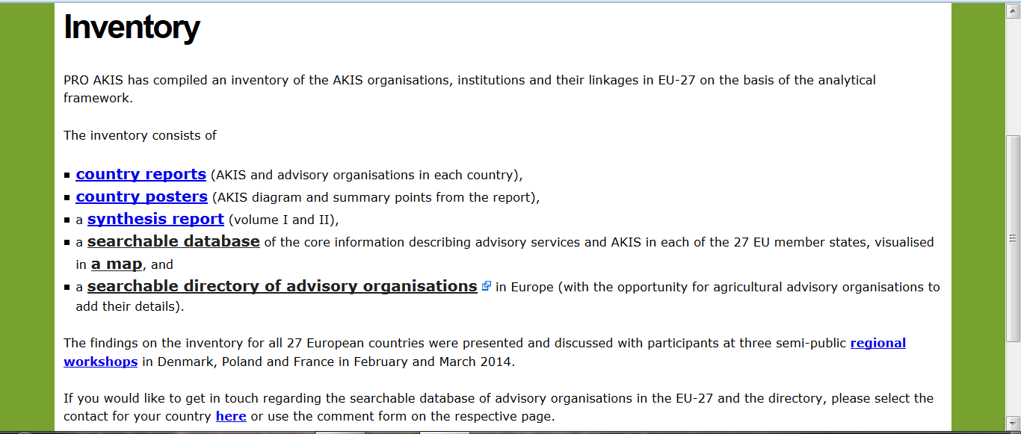
Making of the inventory

Slide 15
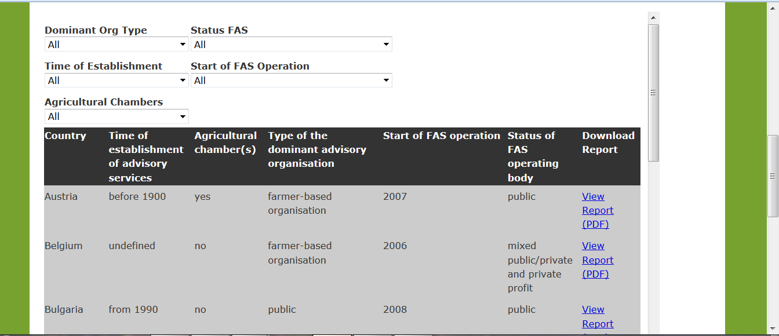
Making of the inventory
Searchable database on advisory servive organisation

Slide 16
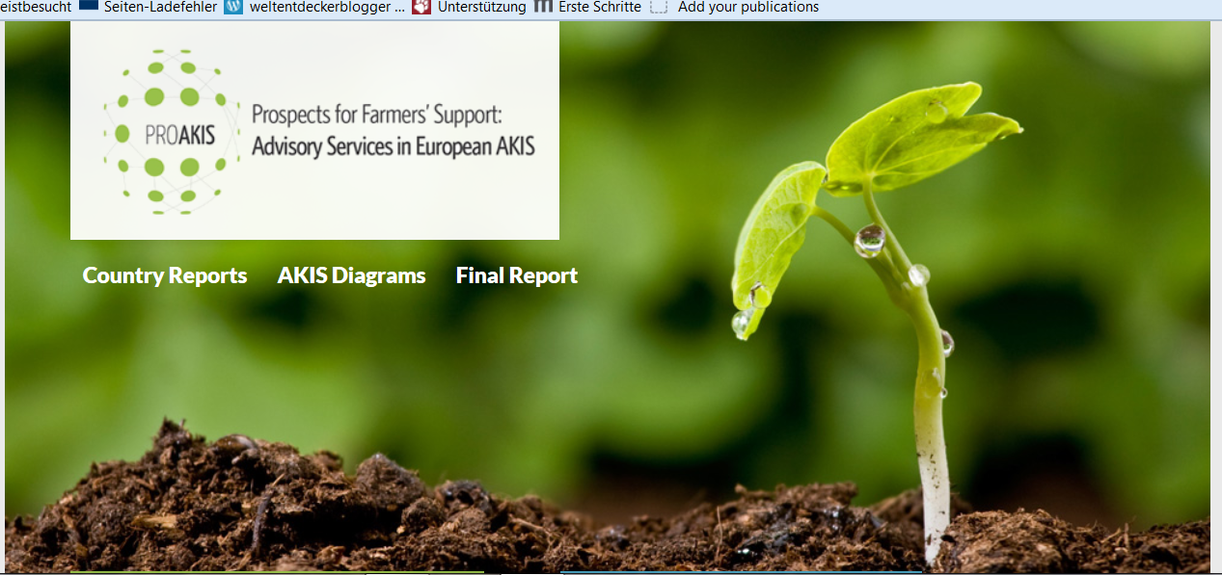
Making of the inventory
Inventory of advisory organisations throughout Europe – to be complemented!

